Slide 1
Java Review Object Oriented Programing
IT 301

Slide 2
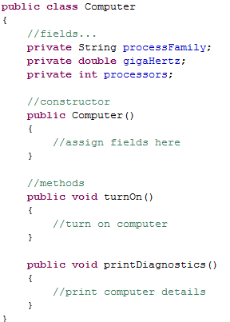
Class design
Classes are blueprints for creating objects
Classes have
Attributes – fields
What does my class store?
Actions – methods
What does my class do?
Each class is created in its own file
The name of the file should be ClassName.java

Slide 3
Fields
Fields should be declared at the top of your class
Format:
[access modifier] [other modifiers] type name;
Examples:
private int total;
public static final String message;
Fields can be assigned an initial value
Fields without initial values are given defaults
Type | Value
numeric | zero
boolean | false
character | null character ‘\u0000’
objects | null

Slide 4
Access modifiers
Determines the visibility of field
Access Modifier | Example | Class | Package | Subclass | World
private | private double radius; | Y | N | N | N
public | public static final int MAX = 10; | Y | Y | Y | Y
protected | protected String name; | Y | Y | Y | N
package (unspecified) | int number; | Y | Y | N | N

Slide 5
Three Pillars of OOP
OOP
Encapsulation
Polymorphism
Inheritance
Intentionally hiding
data – abstraction!
Code reuse!
Dynamic behavior!

Slide 6
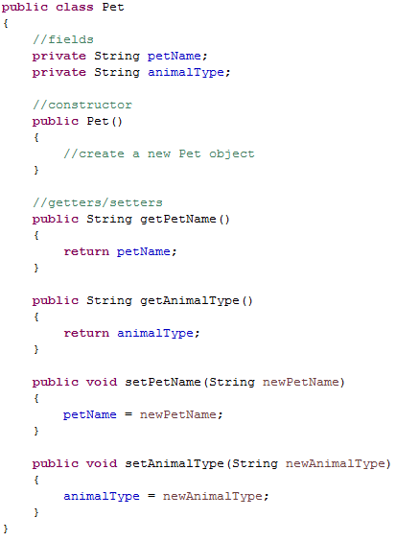
Encapsulation
Hiding the internal details of a class
Private fields
Public accessors/mutators
Benefits?
Simplification
Abstraction
Reducing our concerns

Slide 7

Encapsulation
Users are concerned with the public interface of a an object
Public interface (public methods)
getAverageMPG()
isMadeInUsa()
calculateResellValue()
Car Object
make, model
engineType
milesDriven
can see
User
Internal details

Slide 8
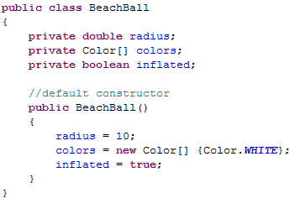
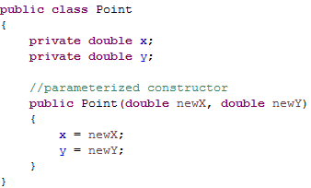
Constructors
Methods used to create an object
Typically are passed values to store in fields
Constructors vs. methods
No return type
Name of constructor is the name of your class

Slide 9

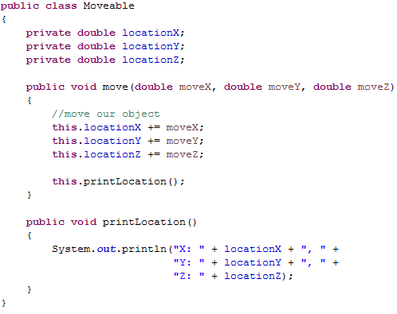
“this” keyword
Used to describe the object a method is called upon
creates
moveable object
locationX = 0
locationY = 0
locationZ = 0
Refer to field
Refer to method

Slide 10
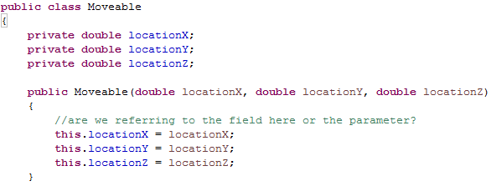
Uses for “this”
Differentiating between ambiguous names

Slide 11
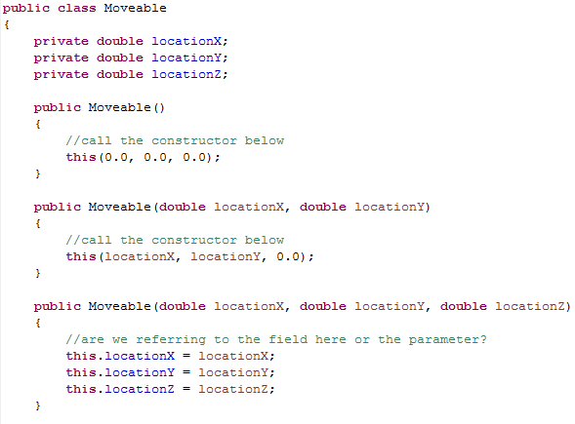
Uses for “this”
Constructor chaining
You can call a constructor from another constructor

Slide 12
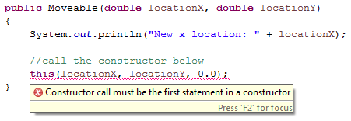
Constructor chaining
Benefit: reduces redundancy!
Constructors often contain significant code
Field assignment
Validation
Pitfall: only create constructors that are being used or are likely to be used
Avoid creating constructors just to create them
Rule: Any call to this() must be the first line in a constructor

Slide 13


Accessors and mutators
Public methods used to access your encapsulated fields
Alternative names
Accessors – getters
Mutators – setters
Accessor – retrieves a field | Mutator – sets a field

Slide 14
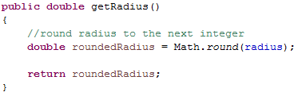
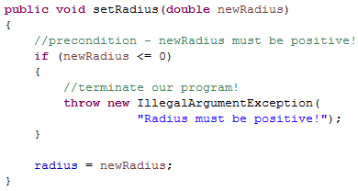
Accessors and mutators
Naming conventions
The format of an accessor/mutator is required
eg. getFieldName(), setFieldName()
You can control access to a field now!

Slide 15
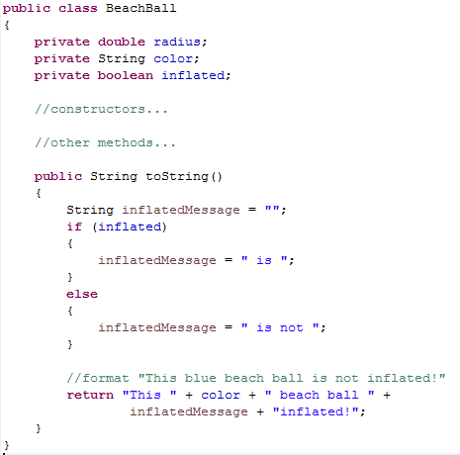
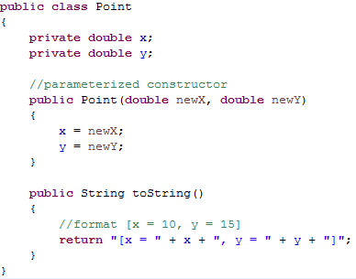
Other methods
toString() method
Returns a string representation of an object
Every class should define this method!
Useful for debugging!

Slide 16

Let’s write some code!
Pick an object!
Shark, ladder, apple, computer, phone….
Attributes (fields)?
Actions (methods)?

Slide 17
Inheritance
Definition: a class borrowing “functionality” from another class
Goal: to reduce redundant (repeated) code
Hourly Employee
First, last name
Address
Birthdate
Position
Hourly wage
Hours worked
Salary Employee
First, last name
Address
Birthdate
Position
Salary
Benefits
shared data

Slide 18
Inheritance
Move shared data to a common class
Then “borrow” that data
Employee
First, last name
Address
Birthdate
Position
Hourly Employee
Hourly wage
Hours worked
Salary Employee
Salary
Benefits

Slide 19
Inheritance
This new relationship is called inheritance
We say a “child” class “inherits” from a “parent” class
What is inherited?
All public fields and methods
Other terminology
Parent Class
Base class
Super class (Java)
Child Class
Derived class
Sub class (Java)

Slide 20
Inherited functionality
Classes
Objects
Employee
First, last name
Address
Birthdate
Position
Fields | Methods
Name Address Birthdate Position | getName() getAddress() toString()
Parent
Hourly Employee
Hourly wage
Hours worked
Fields | Methods
Hourly wage Hours worked Name Address Birthdate Position | getHourlyWage() getHoursWorked() getName() getAddress() toString()
Child

Slide 21
Inheritance
Single inheritance: a class can have only one parent class
A parent class can have any number of children
Employee
Hourly Employee
Salary Employee
Intern
Contractor

Slide 22
Inheritance
Multiple inheritance: where a class has more than one parent
Not supported in Java! (this is a good thing)
Tax Payer
Employee
Hourly Employee

Slide 23
Levels of abstraction
Each class can have a parent class, including your parent
These relationships are called IS-A relationships
eg. An hourly employee is an employee. An employee is a tax payer.
Relationships should mirror their real-world counterparts
This is one of the strengths of OOP programming!
Tax Payer
Employee
Hourly Employee

Slide 24
Class hierarchies
Hierarchies of parent-child relationships can be used to represent real world objects
Tax Payer
Employee
Hourly Employee
Intern
Salary Employee
Part Time Employee
Full Time Employee
Engineer Employee
Manager Employee

Slide 25
Terminology
Tax Payer
parent
Employee
child
Hourly Employee
Intern
Salary Employee
Part Time Employee
Full Time Employee
Engineer Employee
Manager Employee

Slide 26
Terminology
Tax Payer
Employee
ancestors of
SalaryEmployee
Hourly Employee
Intern
Salary Employee
Part Time Employee
Full Time Employee
Engineer Employee
Manager Employee

Slide 27
Terminology
Tax Payer
Employee
descendants of
Employee
Hourly Employee
Intern
Salary Employee
Part Time Employee
Full Time Employee
Engineer Employee
Manager Employee

Slide 28
Inheritance
A class inherits functionality from all ancestors
Tax Payer
getSSN()
calculateTaxes()
Employee
getSSN()
calculateTaxes()
getFullName()
getPosition()
functionality
Hourly Employee
getSSN()
calculateTaxes()
getFullName()
getPosition()
calculatePaytotal()
getHours()

Slide 29
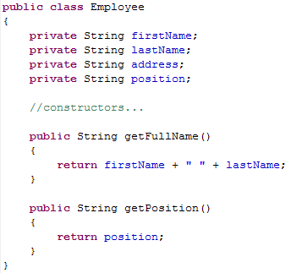
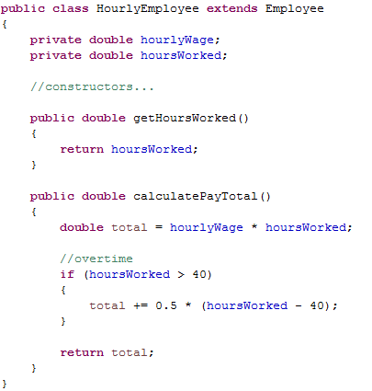
Example
Extends keyword declares a
parent/child relationship

Slide 30
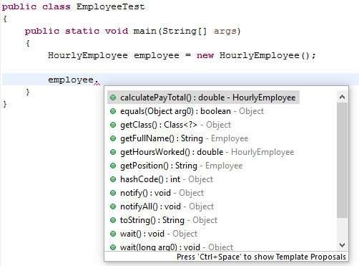
Example
Methods from Employee
Methods from
HourlyEmployee
Methods from Object

Slide 31
Object class
Rule: If a class does not inherit from another class, then it automatically inherits from the Object class
Object
Abbreviated list of Object methods
toString(): returns a string representation of an object
equals(): compares two objects for equality
hashcode(): generates a number used for “quick” equality checks
getClass(): returns an object that can describe a class
Tax Payer
Employee
Hourly Employee

Slide 32
Object class
Outcomes of Object as an ancestor class
The top class in every class hierarchy is Object
Every class in Java (new or existing) inherits from Object
Every class has a toString() or equals() method

Slide 33
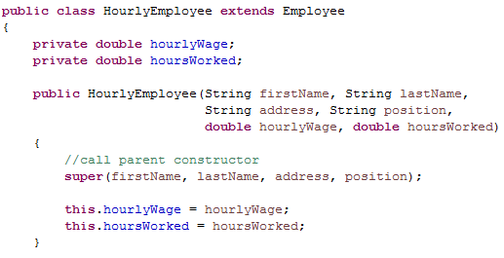
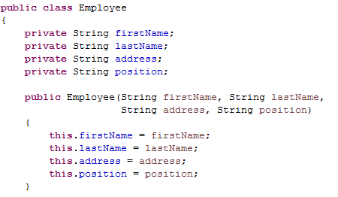
Super constructors
A child class can call the constructor of a parent class

Slide 34

Super constructors
Used to pass data up to a parent class
1. Pass values to HourlyEmployee constructor
2. Parameters are passed to super()
3. Values are assigned in Employee
4. Values are assigned HourlyEmployee

Slide 35
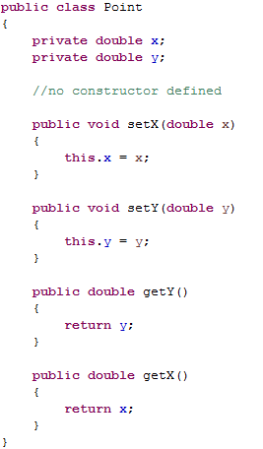

Implicit constructors and calls
Rule: if no constructor is defined in a class, a default constructor is added implicitly
call made to implicit
default constructor

Slide 36
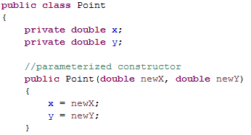
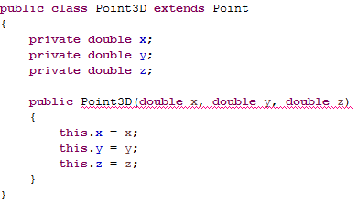
Implicit constructors and calls
Rule: if no call is made to a super constructor, a call to super() is made implicitly
super();
is added here

Slide 37
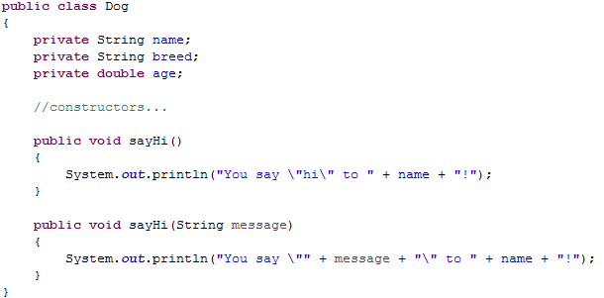
Overloading and overriding
Overloading: two or more methods in the same class with the same name but “different” parameters

Slide 38
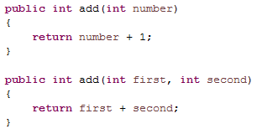
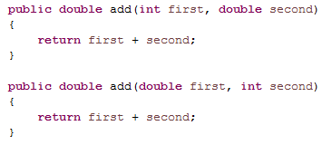
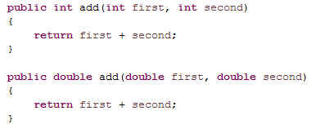
Overloading and overriding
Different parameters
Number of parameters
Types of parameters
Order of parameters

Slide 39
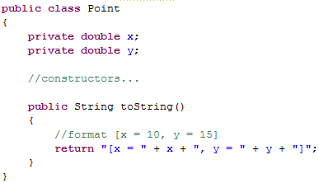
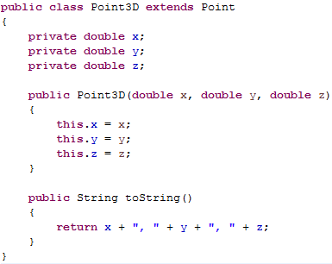
Overloading and overriding
Overriding: redefining a method that a class inherited
Every class inherits the toString() method (why?)

Slide 40
Overloading and overriding
When a method is invoked, it will execute the method that was last overriden
Object
toString()
Point3D newPoint = new Point3D(10, 20, 30);
newPoint.toString();
Point
toString()
Point newPoint = new Point (25, 35);
newPoint.toString();
Point3D
toString()

Slide 41
Let’s write some code!
Shapes!
Attributes?
width, height?
radius?
base, height?
Actions?
public double area()
Shape
shapeName
Rectangle
width, height
Oval
radiusX, radiusY
RightTriangle
base, height
Square
Circle

Slide 42
Abstract classes
Sometimes it does not make sense to instantiate a class
//is this useful?
Shape myShape = new Shape(“Rhombus”);
Shape
shapeName
Rectangle
width, height
Oval
radiusX, radiusY
RightTriangle
base, height
Square
Circle

Slide 43
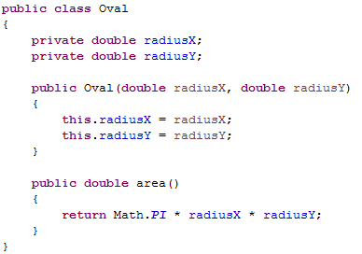
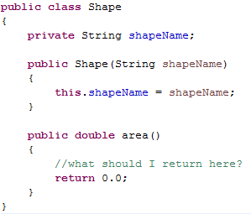
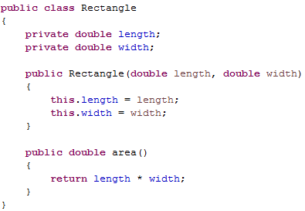
Abstract classes
Sometimes we only write a method in a parent class so that it can be overridden in a child class

Slide 44
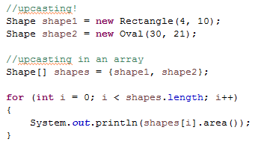
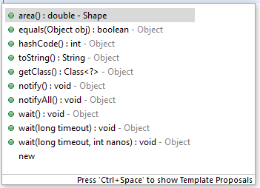
Abstract classes
We can use upcasting to group our shapes
Only methods from the variable type (Shape) can be called from the variable

Slide 45
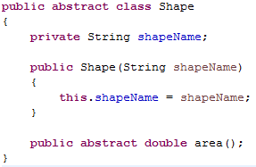
Abstract classes
Allows us to define a parent class that
cannot be instantiated
has methods whose only purpose is to be overridden (abstract methods)
abstract keyword
no method body

Slide 46

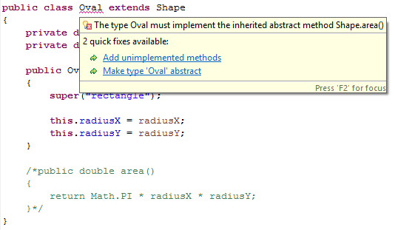
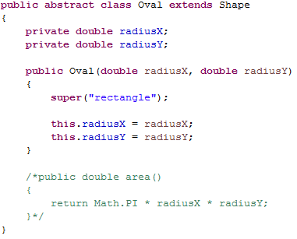
Abstract class
Rule: you cannot instantiate an abstract class
Rule: a child class must implement all abstract methods of an parent class OR must also be abstract

Slide 47
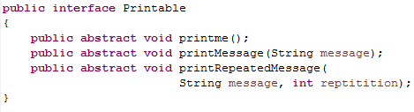
Interfaces
Java interfaces contain abstract methods
An interface is declared in its own file
The public and abstract keywords are optional (and implied)

Slide 48
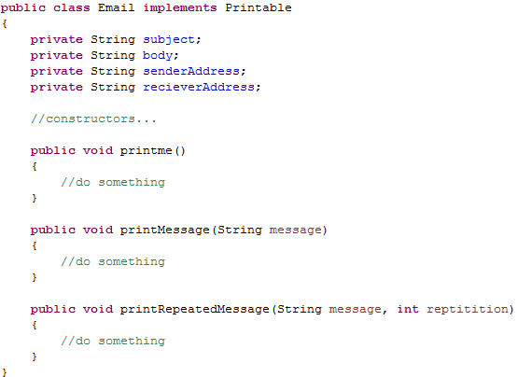
Interfaces
We say that a class implements an interface
“implements” rather
than “extends”

Slide 49

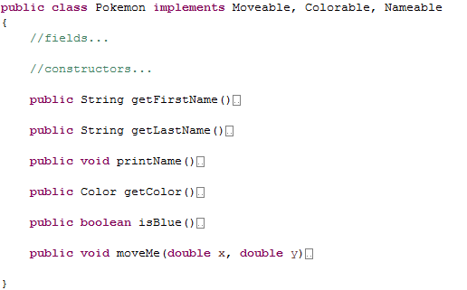


Interfaces
Java does not support multiple inheritance
Java approximates multiple inheritance by supporting multiple interfaces per class

Slide 50
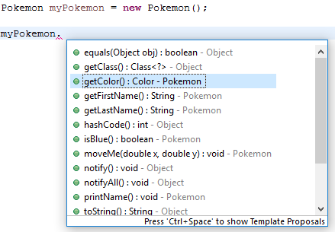
Interfaces
Multiple interfaces
Colorable
Nameable
Moveable

Slide 51
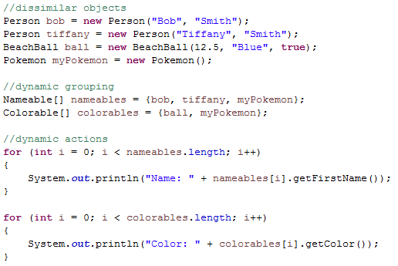
Interfaces
Dynamic grouping

Slide 52

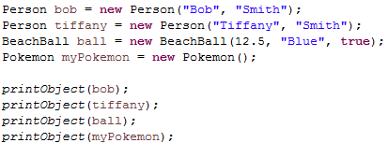
Polymorphism
Definition: objects taking on dynamic form or function
This is possible with upcasting and method overriding
Example
What do we know about the “input” parameter?
What type of object is in that variable?
Where is the toString() method defined? In the Object class?

Slide 53
Static vs. non-static
A field can be declared static
The field is shared among all instances of the class
eg. There is only one data value for that field
Point
x, y
static pointCount
class
pointCount = 3
x = 10
y = 20
x = -2
y = 5
x = 44
y = 100
objects

Slide 54
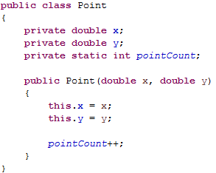
Static vs. non-static
If we have 100 instances of a class we have:
100 of each field in the class, one per object
1 of each static field, shared by each object

Slide 55



Static vs. non-static
Constants
should be static fields
can be made public without breaking encapsulation (why?)
You should access static content from a class name, not an instance variable
“static way”
“non-static way”

Slide 56
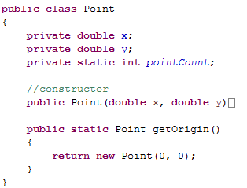

Static vs. non-static
A method can be declared static
No object is required to invoke the method, only the class name

Slide 57
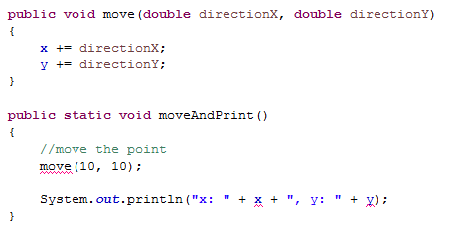
Static vs. non-static
When inside of a static method your code is within a static context
There is no object associated with the method call
Rule: you cannot access non-static fields
Rule: you cannot access non-static methods (which might try to access non-static fields)
cannot access
non-static method
cannot access
non-static field

Slide 58
Static class content
Math class
Fields
Math.PI, Math.E
Methods
Math.pow(), Math.abs(), Math.round()…
String class
String.valueOf()
Integer, Double class
Integer.parseInt(), Double.parseDouble()

Slide 59
Java Review Object Oriented Programing
IT 301

